Slide 1



CSST106
EXPLORING THE ROLE OF COMPUTER VISION AND IMAGE PROCESSING IN AI
BSCS 4A
Andrel John M. Pantanoza

Slide 2
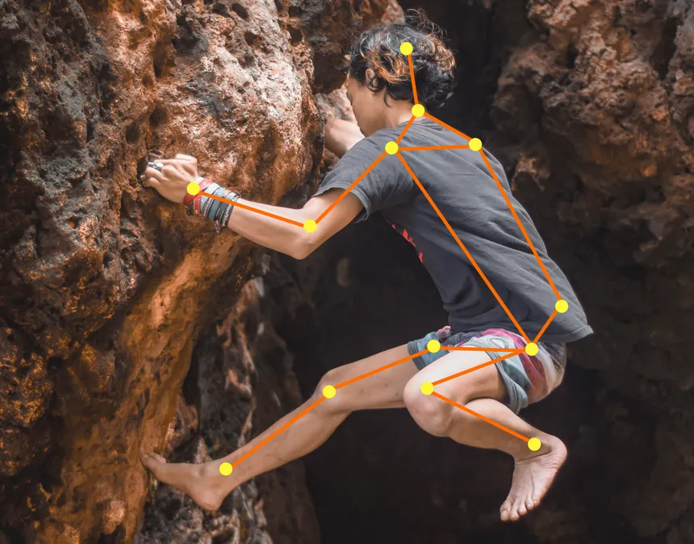
Introduction
INTRODUCTION
COMPUTER VISION AND IMAGE PROCESSING
Computer Vision
Image Processing in AI
Computer Vision allows AI to interpret and process visual information from the world. It enables machines to perform tasks that typically require human vision, such as identifying objects, recognizing people, and making decisions based on visual input. These systems use algorithms to process digital images and videos, converting visual data into numerical or symbolic forms that AI systems can analyze.
Image processing is the technique of manipulating and enhancing images to extract meaningful information. For AI, image processing is a crucial step that prepares raw visual data by removing noise, enhancing details, and focusing on relevant features. This process is especially important for improving the accuracy of AI models in various tasks like object detection, facial recognition, and medical diagnostics. By using these techniques, AI can interpret the visual world more effectively and accurately perform complex tasks.

Slide 3

Additional Paragraph
ADDITIONAL INFORMATION
Computer vision and image processing are foundational components of AI’s ability to interact with the world. The relationship between the two is symbiotic: computer vision helps machines “see” the world, while image processing refines what they “see” to make it usable for decision-making. Whether in autonomous vehicles, healthcare, or surveillance, the role of image processing is to ensure that AI systems can function effectively in real-time, by pre-processing images for optimal performance.

Slide 4

Types of Image Processing Techniques
TYPES OF IMAGE PROCESSING TECHNIQUES
1
Filtering : Filtering involves modifying or enhancing an image by suppressing or highlighting specific parts of the data. A common use is removing noise (unwanted variations in brightness or color) from an image while preserving important details. Example: Gaussian Blur is used to smooth an image and reduce noise, making it easier to detect edges and shapes.
2
Edge Detection: Edge detection is a technique used to find the boundaries within an image. These boundaries often represent object edges, so detecting them helps in understanding the shape and size of objects. Example: The Canny Edge Detection algorithm is widely used to identify the edges of objects in images, which can then be used for object recognition or boundary tracking in various AI applications.
3
Image Segmentation: Image segmentation is the process of dividing an image into multiple parts or regions. Each segment represents a meaningful part of the image, such as different objects or areas. Example: In medical imaging, segmentation is used to identify and isolate specific areas, such as detecting tumors in MRI scans, enabling precise analysis and diagnosis.

Slide 5

Additional Paragraph
ADDITIONAL INFORMATION
Each of these techniques plays a vital role in helping AI systems interpret visual data more efficiently. For example, filtering helps in pre-processing the image to make further analysis easier, while edge detection and segmentation provide more detailed insights into the structure of the image. AI applications like facial recognition systems and self-driving cars rely heavily on these techniques to make sense of the complex visual environments they operate in. Without them, AI systems would struggle to extract meaningful information from raw visual data, leading to poor performance and unreliable results.

Slide 6
Case Study
CASE STUDY OVERVIEW
Title: Case Study: Autonomous Vehicles
Content:
Techniques Used:
Challenges Addressed:
Application:
Autonomous vehicles, such as those developed by companies like Tesla, depend heavily on computer vision to interpret their surroundings. These cars use visual data to identify lane markings, detect pedestrians, and recognize road signs. By processing visual inputs from cameras, these vehicles can make real-time decisions and navigate safely without human intervention.
Edge Detection:
This technique helps autonomous vehicles detect lane boundaries, ensuring the vehicle stays within its designated lane. It’s particularly useful in poor visibility conditions like night driving or fog.
The main challenge for autonomous vehicles is ensuring real-time processing of visual data while maintaining high accuracy. The system needs to react instantly to dynamic environments and changes in road conditions. Image processing techniques are essential in overcoming these challenges by providing clear, interpretable data that the vehicle can use to make informed decisions.
Segmentation:
Segmentation allows the vehicle to differentiate between objects on the road, such as other vehicles, pedestrians, and obstacles. By segmenting the road into different areas, the car can make safe navigation decisions.

Slide 7
Additional Paragraph
ADDITIONAL INFORMATION
In addition to these techniques, autonomous vehicles also integrate other AI technologies, such as machine learning and sensor fusion, to interpret their surroundings with greater accuracy. Edge detection is used for tasks like lane-keeping and object detection, while segmentation helps in identifying and differentiating between pedestrians, vehicles, and obstacles. The ability to process these complex visual environments in real-time is what allows autonomous vehicles to function safely in unpredictable conditions, from busy intersections to changing weather

Slide 8
Image Processing Implementation
YOUR IMAGE PROCESSING IMPLEMENTATION
Title: Edge Detection for Lane Detection in Autonomous Vehicles
Content:
Techniques Used:
How it Works:
Problem Addressed:
Lane detection is a critical function for autonomous vehicles, as it ensures the car stays in the correct lane while driving. However, poor lighting, worn-out lane markings, or adverse weather conditions can make lane detection challenging.
Solution (Edge Detection):
A Canny edge detection algorithm can be used to identify lane boundaries in road images. This technique detects changes in image intensity to highlight the edges of the lanes, making it easier for the autonomous system to recognize the boundaries and adjust the vehicle's position accordingly.
The Canny edge detection algorithm works by detecting points where the brightness of an image changes rapidly. These points usually correspond to the edges of objects or, in this case, the boundaries of lanes. Once the lanes are identified, the vehicle can calculate its position relative to the lanes and make necessary steering adjustments.

Slide 9
Additional Paragraph
ADDITIONAL INFORMATION
In real-world implementations, lane detection systems often combine multiple techniques, such as edge detection and machine learning algorithms, to improve accuracy. For example, combining edge detection with a Hough Transform can help better identify straight and curved lanes, even in complex road scenarios. These systems must also handle varying road conditions, such as faded lane lines or temporary road markings, making it essential for image processing techniques to be both robust and adaptive.

Slide 10

Conclusion
CONCLUSION
Summary of Key Points:
Image processing is an essential part of AI systems, particularly in applications that require interaction with visual data. Techniques such as filtering, edge detection, and segmentation allow AI to extract and interpret meaningful information from images, improving the system’s ability to recognize patterns and make decisions.
Reflection:
Through the exploration of techniques like edge detection and segmentation, we can see how these methods help solve complex real-world problems. Whether it's ensuring the safety of autonomous vehicles or diagnosing medical conditions, effective image processing is key to building reliable AI systems.

Slide 11
Additional Paragraph
ADDITIONAL INFORMATION
Looking forward, the role of image processing in AI is likely to grow even further, with emerging technologies such as deep learning pushing the boundaries of what AI can achieve. As AI continues to evolve, so too will the sophistication of the image processing techniques that underpin it, leading to more advanced, accurate, and efficient systems capable of handling increasingly complex visual data in real-time.

Slide 12
Extension Activity
EMERGING TECHNIQUE: DEEP LEARNING-BASED IMAGE ANALYSIS
Title: Deep Learning-Based Image Analysis
Content:
How It Works:
Applications:
Overview of Deep Learning in Image Processing:
Deep learning, particularly using Convolutional Neural Networks (CNNs), has revolutionized image analysis. Unlike traditional image processing techniques that require manual feature extraction, CNNs automatically learn features directly from the raw image data. These networks can identify patterns and structures within images with much greater accuracy and efficiency than previous techniques.
CNNs consist of multiple layers that analyze an image in increasingly complex ways. The early layers detect simple patterns like edges and colors, while deeper layers identify more abstract features like shapes, objects, or even entire scenes. Deep learning models are trained on massive datasets, allowing them to generalize and recognize complex features in unseen images.
This technique is widely used in areas like facial recognition, autonomous vehicles, and medical image analysis. For instance, in healthcare, deep learning models are capable of detecting diseases from medical images with accuracy comparable to or surpassing human experts. Autonomous vehicles use CNNs for object detection and scene recognition to navigate complex environments safely.

Slide 13
Additional Paragraph
ADDITIONAL INFORMATION
Deep learning is set to have a profound impact on the future of AI systems, as it allows for real-time, highly accurate image processing at a scale never seen before. Future AI systems will likely rely on deep learning for more sophisticated tasks such as real-time surveillance, advanced robotic vision, and AI-powered diagnostics in medicine. As these models continue to evolve, they will push the boundaries of what AI systems can achieve with visual data.

Slide 14
Extension Activity
POTENTIAL IMPACT ON FUTURE AI SYSTEMS:
Scalability and Efficiency:
Accuracy and Precision:
Integration with Other AI Technologies:
Deep learning models are extremely scalable, meaning they can handle very large datasets and process vast amounts of visual data in real time. This is particularly important for applications like autonomous vehicles and smart cities, where large-scale image data needs to be processed continuously.
Deep learning-based image processing has already demonstrated remarkable accuracy in tasks like medical diagnosis (e.g., detecting cancerous cells) and facial recognition (e.g., security systems). As models and computational power improve, we can expect even greater precision and fewer errors.
As deep learning-based image processing becomes more advanced, it will be integrated with other AI technologies such as natural language processing (NLP) and decision-making algorithms, enabling more holistic AI systems that can understand and interact with the world in a human-like way.

Slide 15
THANK YOU

